Slide 1



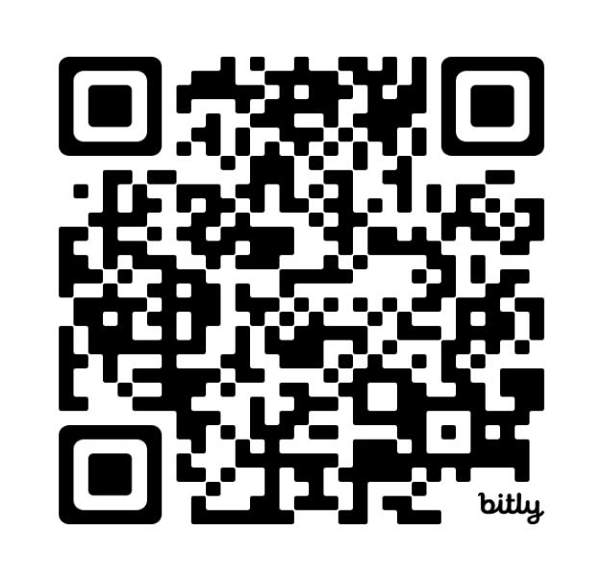
Antifungal consumption in Belgium between 2015 and 2023
Maximiliaan De Preter¹, Ann Versporten², Ines Pauwels², Annelies Boven², Erika Vlieghe^{1,2}
¹General Internal Medicine, Infectious Diseases and Tropical Medicine, Antwerp University Hospital, Antwerp, Belgium, ²Laboratory of Medical Microbiology, Vaccine and Infectious Disease Institute, University of Antwerp, Antwerp, Belgium
BSHAM Annual Symposium 2025
Contact : maximiliaan.depreter@uza.be
BACKGROUND & OBJECTIVES
METHODS
    First Fungal Priority Pathogens list to guide research, development and public health action (1).
    Belgium has a historically high antifungal consumption per capita (2).
    Determine Belgian antifungal consumption from 2015 onwards.
    Describe prescribing patterns of antifungal therapy in Belgian hospitals.
    Analysis of national reimbursement statistics through Pharmanet concerning antifungal therapy from 2015-2023.
    Comparison of community and hospital sector and all Belgian districts.
    Comparison with other European countries through European Surveillance of Antimicrobial Consumption Network.
    Descriptive analysis of Global-PPS in Belgian hospitals from 2015-2022 (402 surveys of 140 acute care hospitals).
RESULTS
Antifungal agent (n=1216) | Gastro-intestinal | Respiratory | Medical prophylaxis | Undocumented indication | Sepsis and BSI | Urogenital | Skin and soft tissue | Surgical prophylaxis | Deep site
Fluconazole (n=805) | 28.0% | 9.7% | 20.9% | 15.7% | 7.6% | 9.4% | 3.7% | 2.9% | 2.2%
Voriconazole (n=117) | 2.6% | 88.0% | 0.9% | 1.7% | 1.7% | 0% | 0.9% | 0% | 4.3%
Posaconazole (n=82) | 0% | 9.8% | 70.7% | 14.6% | 0% | 0% | 0% | 4.9% | 0%
Caspofungin (n=70) | 18.6% | 27.1% | 11.4% | 10.0% | 28.6% | 0% | 0% | 0% | 4.3%
Amphotericin B (n=47) | 2.1% | 53.2% | 8.5% | 4.3% | 12.8% | 0% | 0% | 6.4% | 12.8%
Anidulafungin (n=32) | 34.4% | 9.4% | 3.1% | 0% | 40.6% | 9.4% | 3.1% | 0% | 0%
Consumption patterns in antifungal therapy (n=1216)
CONCLUSION
REFERENCES
Scan for more info on Global-PPS
Antifungal consumption per capita is 2.4x higher in Belgium compared to the average of the EU, driven mainly by usage in the community. Further research is needed to determine indications for antifungal therapy in the public sector.
Successive point prevalence surveys such as Global-PPS are time- and cost-effective to monitor antifungal consumption and reported indications.
Antifungal stewardship initiatives focusing on the distinction of fungal colonization and infection might be effective to reduce antifungal consumption in the hospitalized patients.
1. Sati H, Beardsley AA-IJ, Morrissey O, Alffenaar J-W, Howard K, Kim HY, et al. WHO fungal priority pathogens list to guide research, development and public health action. Geneva: World Health Organization, Division WHOAR; 2022.
2.Goemaere B, Lagrou K, Spriet I, Hendrickx M, Vandael E, Becker P, et al. Systemic antifungal drug use in Belgium—One of the biggest antifungal consumers in Europe. Mycoses. 2019;62(6):542-50.
Disclosures: bioMérieux is the sole industrial partner of the Global-PPS. The company has no role in study design, data collection, data analysis, data interpretation, or writing the report.
Data are strictly confidential and stored anonymously at the coordinating centre of the University of Antwerp.

