Slide 1
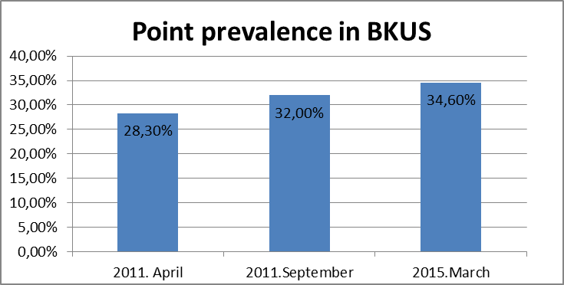
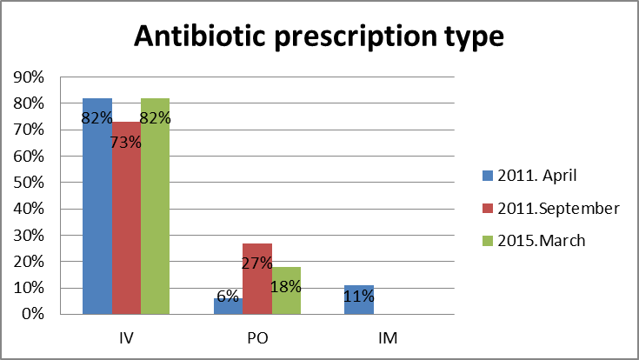
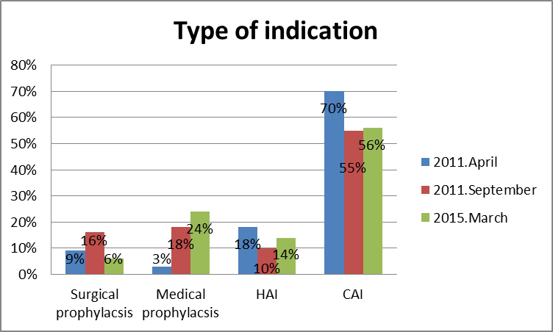
Antimicrobial Point Prevalence Survey in University Children’s Hospital Latvia
Kristine Rasnaca^{1,2}, Dace Gardovska^{1,2}, Jana Pavare^{1,2}, Herman Goossens³, Ann Versporten³, Ilze Grope^{1,2}
¹University Children’s Hospital, Latvia
²Riga Stradins University, Latvija
³Faculty of Medicine and Health Science, Campus Drie Eiken - S6.23, Universiteitsplein 1 - 2610 Antwerp, Belgium
Background: Antibiotics are the most popular prescribed treatment for community-acquired infection and healthcare associated-infection. In literature point prevalence for hospitalized children was reported 17-59%. Inappropriate and excessive use of antibiotics among hospitalized children has been linked to the emergence of antibiotic-resistant bacteria that may spread and persist in hospitals and the community. There is a critical need for antimicrobial prescribing control for children.
Aims: Explore the antimicrobial point prevalence in University Children’s hospital Latvia.
Methods: One day point prevalence survey (PPS) on antimicrobial use in hospitalized children in University Children’s Hospital was organized in 05.04.2011 – A, 21.09.2011 – B, 25.03.2015 – C. There was collected data from medicine documents about all children hospitalized till 8:00 clock and prescribing one or more antibiotics.
Results: There were A-364, B-328 and C-338 hospitalized patients at survey day. Antibiotic use was A-103 (28,3%), B-105 (32,0%) and C-117 (34,6%), in surgery departments A-26 (33,3%), B-31 (29,5%) and C-22 (32,4%), in pediatric departments A-65 (25,3%), B-57 (28,9%) and C-74 (31,0%), in intensive care departments A-12 (41,4%), B-17 (65,4%) and C-21 (67,7%). Overall antibiotic use was significantly higher in intensive care departments. Antibiotic was prescribing for surgical prophylaxis A-9, B-17 and C-7 patients, for medical prophylaxis A-3, B-19 and C-28 patients, for healthcare associated infection (HAI) A-19, B-11 and C-16 patients and for community acquired infection (CAI) A-72, B-58 and C-66 patients. Most popular prescribed antibiotics were A-Amoxicillinum (18 patients (14,1%)) and Ceftriaxonum (17 patients (13,3%)), B-Sulphamethoxozole/Trimethroprim (20 patients (13,1%)) and Ceftriaxonum (15 patients (9,8%)) and C-Cefuroximum (22 patients (14,9%)) and Amoxicillinum (20 patients (13,5%)). Most popular antibiotic prescription type were intravenous (A-105 (82%), B-112 (73,2%) and C-121 (81,8%)).
Conclusions: In this survey antimicrobial point prevalence in University Children’s Hospital hospitalized patients was A-28,3%, B-32,0% and C-34,6%, what confirms average antimicrobial point prevalence in Europe. However, from this survey we observe, that there are trend to increase point prevalence in University Children’s Hospital.
Notes:
Methods: One day point prevalence survey (PPS) on antimicrobial use in hospitalized children in University Children’s Hospital was organized in 05.04.2011 – A, 21.09.2011 – B, 25.03.2015 – C. There was collected data from medicine documents about all children hospitalized till 8:00 clock and prescribing one or more antibiotics.

