Slide 1

Global Point Prevalence Survey of Antimicrobial Consumption and Resistance
Presenter
www.global-pps.com

Slide 2
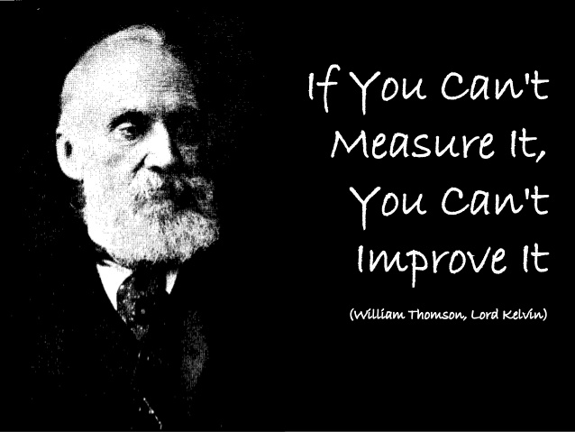
Surveillance
(Lord Kelvin, 1824-1907)

Slide 3

Surveillance
Measurement
  Resistance,
  Antibiotic use,
  Infections…
Objectives
  Assess simultaneously antibiotic use and antimicrobial resistance (AMR) impact
  Define empiric treatments
  Analyze epidemiology trends (resistance and antimicrobial use)
  Evaluate interventions and allocate resources efficiently: set targets for improvement and measure the impact of interventions
To be done at hospital, local, regional, national, global levels

Slide 4
Global-PPS purpose
Monitor rates of antimicrobial prescribing and resistant bugs in the hospital
Benchmark between hospitals, countries, regions
Identify targets to improve quality of antimicrobial prescribing
Identify targets to prevent intervention-related Health-care Associated Infections (HAI)
Help designing hospital interventions to promote prudent antimicrobial use (Antibiotic Stewardship) and improve patient health
Assess effectiveness of interventions through repeated PPS
4

Slide 5
Organization at hospital level
Creation of multidisciplinary team
Allocation of local Global-PPS administrator
Ethics approval
Guarantee of data privacy
  Hospital names will never be revealed in any report or publication
  Complete anonymous patient data-entry
Data are property of the respective hospital
Data privacy excerpt and publication policy are available

Slide 6
Time Frame 2020
Data collection on the wards – three survey periods are available :
  January-April 2020
  May-August 2020
  September-December 2020
Data entry on the Global-PPS tool is possible up to at least two months after the last month of a survey period

Slide 7
Global-PPS data collection, entry and management
Data collection on paper forms :
  Department (Ward) form (denominator data)
  Patient form (numerator data)
  HAI-Patient form – Optional HAI module (numerator data)
Web-based data entry, verification, validation and reporting with the help of the Global-PPS program.
URL:
https://app.globalpps.uantwerpen.be/globalpps_webpps/
SEE IT manual available at www.global-pps.com/documents/

Slide 8
Data collection on paper forms
Department (Ward) form (denominator data)
To be completed for each patient on at least one antimicrobial at 8 am on the day of the PPS (numerator data):
Light version:
Patient form (patient and antimicrobial data)
Full version:
Patient form (patient and antimicrobial data)
HAI-Patient form – (HAI qualitators at patient level)

Slide 9
Departments concerned
All wards (units/departments) of the hospital will be included once (subsample is possible for bigger hospitals, see protocol page 7 !)
Surgical departments are not to be surveyed after a weekend or holiday in order to allow retrospective data collection on surgical prophylaxis.
Denominators collected at department level on the day of the survey:
Total N of patients present on the ward before 8:00 am
Total N of beds on the ward at 8:00 am
Extra denominators for the « optional » HAI module
Data collection is done on a weekday, not on the weekend or a holiday.

Slide 10
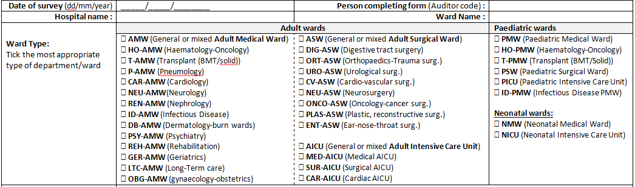
Predefined detailed ward categorization

Slide 11
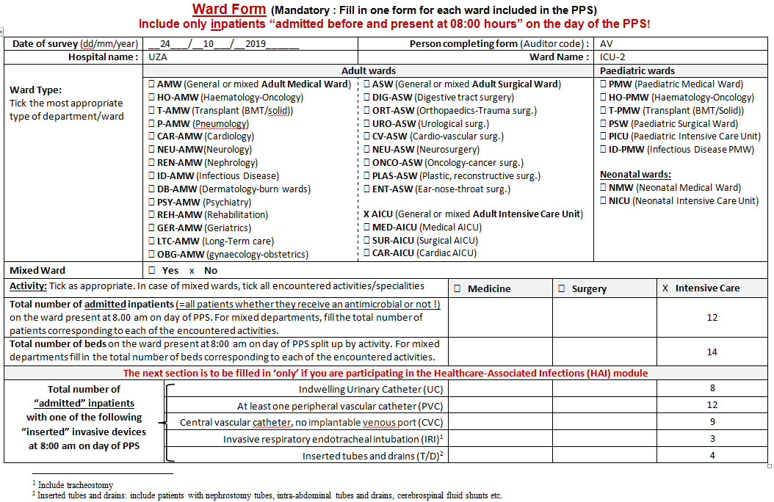
Collection of Denominator data
Optional field for HAI module

Slide 12
Numerator – Inclusion criteria
Include all admitted inpatients receiving an “active/ongoing” antimicrobial prescription at 8 am on the day of survey
In practice, this means 1) For an observed national average antimicrobial prevalence rate of 40% and 2) For a hospital with on average 400 admitted inpatients a day and a bed occupancy of 100%, you will need to collect detailed data for on average 160 inpatients for the entire hospital.

Slide 13
Numerator – Inclusion criteria
Definition of an antimicrobial agent – Which one and when to include ?
  Prescribed at 8 am the day of the survey
  Include active and ongoing antimicrobials: include an ongoing antimicrobial prescribed e.g. 3 times/week but not on the day of the survey
Antimicrobials under surveillance (according to WHO ATC classification; this is done automatically during data-entry by the Global-PPS programme)
  Antibacterials for systemic use: J01
  Antimycotics and antifungals for systemic use: J02 and D01BA
  Antibiotics and other drugs used for treatment of tuberculosis: J04A
  Antibiotics used as intestinal anti-infectives: A07AA
  Antiprotozoals used as antibacterial agents, nitroimidazole derivatives: P01AB
  Antivirals : J05
  Antimalarials: P01B
Antimicrobials for topical use are excluded

Slide 14
Exclusion criteria : to be applied in the numerator and denominator
Day hospitalizations and ambulatory care patients
Patients admitted to the ward after 8 am on the day of the survey
  Those patients are NOT counted in the numerator nor in the denominator!

Slide 15
Essential data to collect: numerator
At the patient level:
Age, gender and weight, for neonates birth and gestational age (optional)
Treatment based on biomarker; which one (CRP, PCT or other lab-based biomarker, WBC count), type of sample and most relevant value
At the antimicrobial prescription level:
Antimicrobial agent/s (substance level - generic name)
Start date antimicrobial (optional)
Dose per administration - N doses/day - route of administration
Reasons for treatment (anatomical site of infection)
  What the clinician intends to treat !
Indication for therapy (Community Acquired or Healthcare Associated Infection; Medical or Surgical Prophylaxis)

Slide 16
Essential data to collect: numerator
At the level of the antimicrobial prescription, next:
Quality indicators
  Reason for therapeutic or prophylactic prescription written in notes?
  Stop and review date of prescription written in notes?
  Prescription compliant with local guidelines?
“Empiric” or “Targeted” treatment
If targeted: complete if available maximum 3 micro-organisms and 1 resistance type per MO (see data collection templates, P9)
  MRSA
  Methicillin-resistant coagulase-negative staphylococci
  PNSP (Penicillin-nonsusceptible Streptococcus pneumoniae)
  MSL (macrolide-lincosamide-streptogramin resistance in Streptococcus isolates)
  VRE
  ESBL-producing Enterobacteriaceae
  3rd generation cephalosporin resistant Enterobacteriaceae non-ESBL producing or ESBL status unknown
  Carbapenem-resistant Enterobacteriaceae
  ESBL-producing nonfermenting Gram-negative bacilli
  Carbapenem-resistant nonfermenting Gram-negative bacilli
  Other MDR organisms
  Azoles (Targeted against resistant antifungals )

Slide 17
Reporting in case of product combination
Combinations of an antibiotic and an enzyme inhibitor:
Ampicillin and beta-lactamase inhibitor: report only ampicillin dose
Amoxicillin and beta-lactamase inhibitor: report only amoxicillin dose
Ticarcillin and beta-lactamase inhibitor: report only ticarcillin dose
Piperacillin and beta-lactamase inhibitor: report only piperacillin dose
Imipenem and beta-lactamase inhibitor: report only imipenem dose
Panipenem and betamipron: report only panipenem
Examples:
Augmentin® 1.2g IV → 1g (amoxicillin) + 200mg (clavulanic acid): report only 1 g
Piperacillin® 4.5g IV → 4g (piperacillin) + 500mg (tazobactam), report only 4 g
Other combinations of multiple antimicrobial substances:
Sulfamethoxazole and Trimethoprim: report total amount of both sulfamethoxazole and trimethoprim
Example:
Cotrimoxazole 960mg: (sulfamethoxazole 800mg + trimethoprim 160mg), report 960mg
See antimicrobial list at www.global-pps.com/documents/

Slide 18
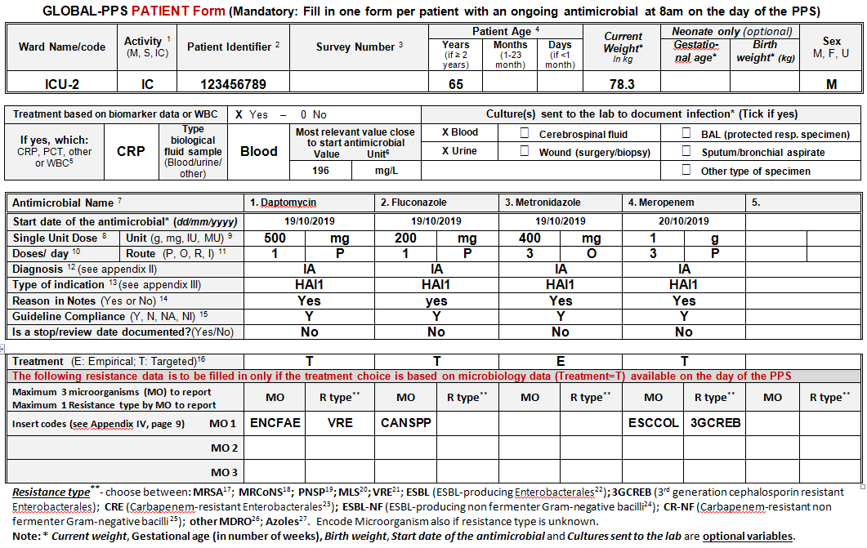
Collection of Numerator data – LIGHT version

Slide 19
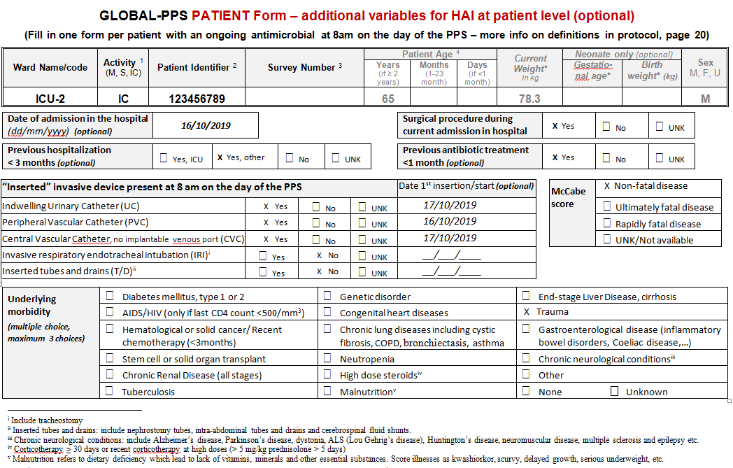
Optional Numerator data for HAI module
- Extra for full version -

Slide 20
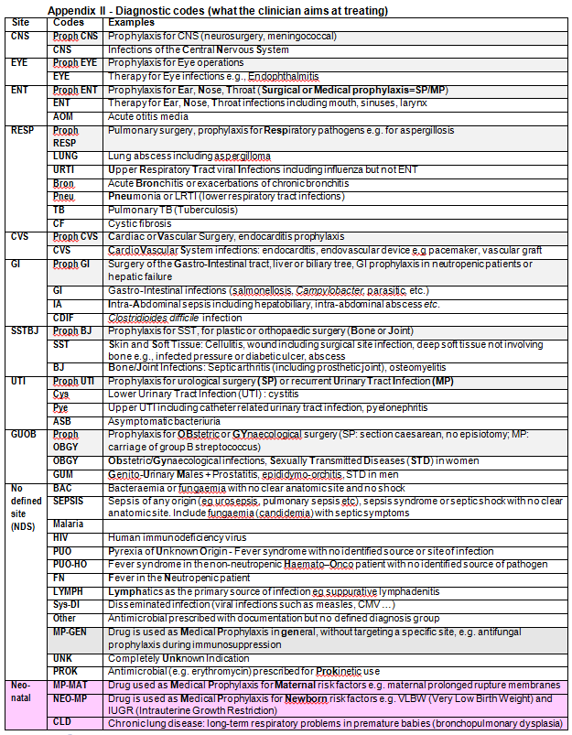

Diagnostic codes
Following anatomical site of infection
For each site choose between:
Therapeutic
Prophylactic
  Surgical
  Medical
Specific codes for neonates are available

Slide 21
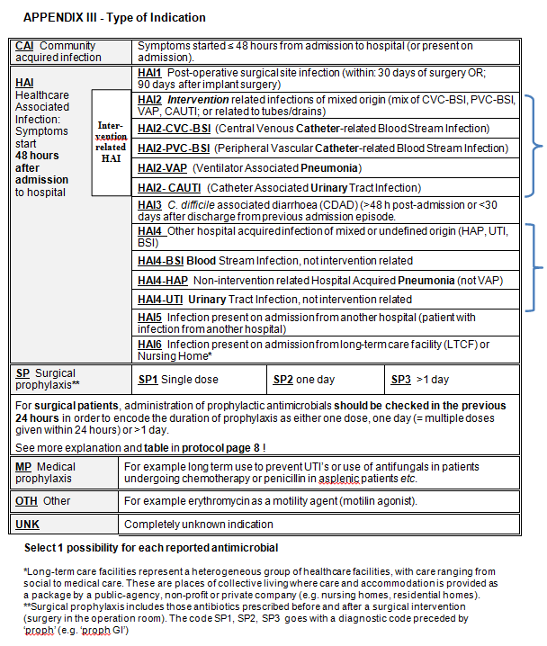
APPENDIX III - Type of Indication
Community acquired
Nosocomial
Prophylaxis
  Surgical
  Medical
Other

Slide 22
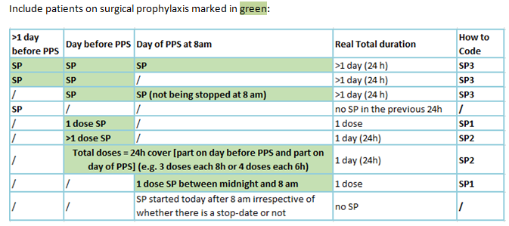
How to encode Surgical prophylaxis
Surgical Wards should be surveyed on the day following the day when most elective surgical interventions usually take place or have been planned in order to capture information about surgical prophylaxis in the previous 24 hours.
This means that “only” patients who got the intervention the day ‘before’ of the PPS, but received the surgical prophylaxis as one dose or one day, will be included in the survey.

Slide 23
List of Micro-organisms by resistance type page 9 data collection forms

Slide 24
Global-PPS data collection, entry and management
Data collection on paper forms :
  Department (Ward) form (denominator data)
  Patient form (numerator data)
  HAI-Patient form – Optional HAI module (numerator data)
Web-based data entry, verification, validation and reporting with the help of the Global-PPS program.
URL:
https://app.globalpps.uantwerpen.be/globalpps_webpps/
See IT manual available at : www.global-pps.com/documents/

Slide 25

Web-based data entry
Login to : https://app.globalpps.uantwerpen.be/globalpps_webpps/login
Forgot password, but you still know username, ask a new password online :
Forgot username and password : contact Global-PPS@uantwerpen.be
Don’t forget to tick the captcha !
Change of local administrator : contact Global-PPS@uantwerpen.be

Slide 26
Preparatory work – New hospital
Define your hospital : go to Institutions/New
Contact Global-PPS@uantwerpen.be if you are unable to find the correct geographical information for your hospital.
Register each institution one by one.
Go to Institutions/overview to display the list of hospitals
Ensure that the correct institution is activated during data entry
(see black bar at the top of the page)

Slide 27
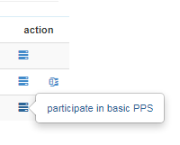
Preparatory work – New hospital, next
Select the survey to which you want to participate
  First go to Surveys/Available and click under action:
    Participate in basic PPS (=light version) or
    Participate in PPS icl. HAI (=full version)
  Thereafter go to Surveys/Subscribed and click on the checkmark to activate the survey. The survey will now appear in the black bar at the top of the page.
    Note that, as long as you did not enter any ward/patient data, it is still possible to switch from basic PPS (light version) to HAI-enabled PPS and back by selecting or deselecting the checkbox below ‘HAI module enabled’.
Next, create your departments one by one : go to Departments/New
  These departments will appear later in the drop-down list during entry of survey data
Be aware : each department “must have a unique name”

Slide 28
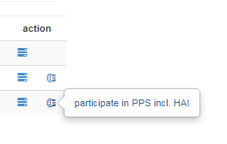
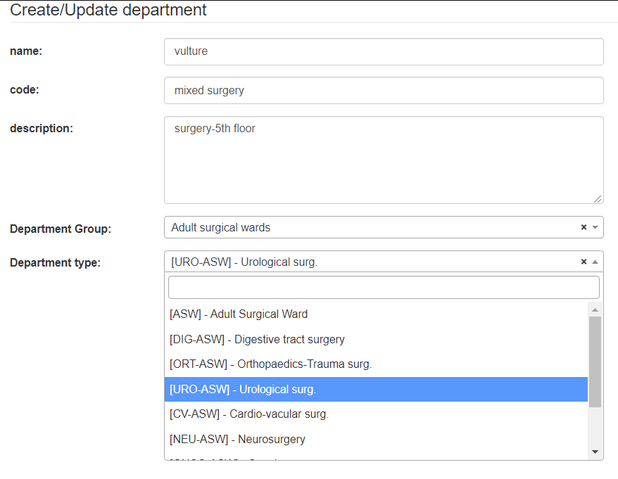
Preparatory work – Existing hospital
Select the survey to which you want to participate
  First go to Surveys/Available and click under action:
    Participate in basic PPS (=light version) or
    Participate in PPS icl. HAI (=full version)
  Thereafter go to Surveys/Subscribed and click on the checkmark to activate the survey. The survey will now appear in the black bar at the top of the page.
    Note that, as long as you did not enter any ward/patient data, it is still possible to switch from basic PPS (light version) to HAI-enabled PPS and back by selecting or deselecting the checkbox below ‘HAI module enabled’
Go to departments/overview
and update your departments
one by one by selecting the
new appropriate department type

Slide 29
Web-based data entry
-Summary-
Enter your denominators collected at ward level, one by one (go to Surveys/New ward)
Enter detailed patient data one by one (go to Surveys/New patient)
You can download your own data in excel at all times (go to Surveys/Export)
After all data are entred online, validate your data (go to Surveys/Subscribed and click under action ‘validate the survey’)
After validation, go to Surveys/Subscribed and click under action ‘send feedback report by mail’

Slide 30
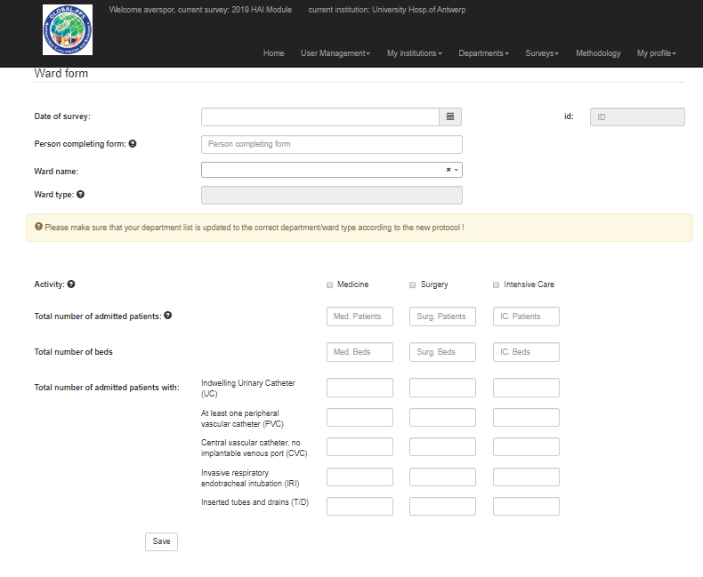
Add denominators (ward form)
Define your denominators by ward, one by one.
You will only be able to enter detailled patient data after completing the denominators in the ward form
Go to Surveys/Wards for an overview of your wards.
You can also edit the information if needed.

Slide 31
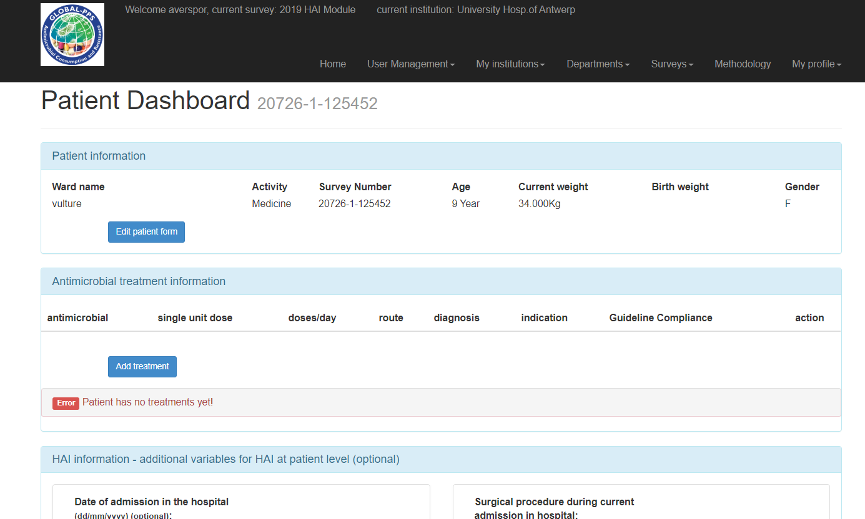
Add patients
Treatment still need to be entered online!
Survey number is provided after saving the patient onto the Global-PPS tool
Do not forget to write down this number on the paper form !

Slide 32
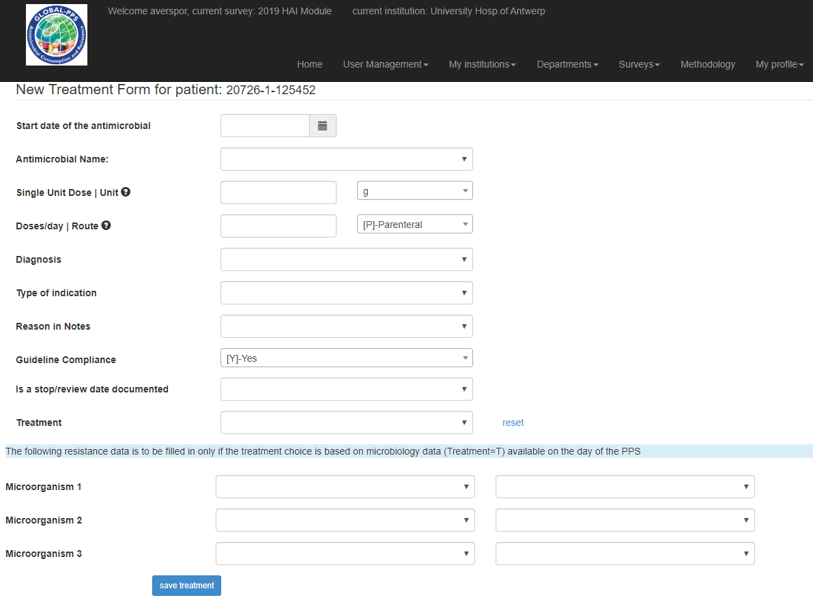
Add treatments

Slide 33
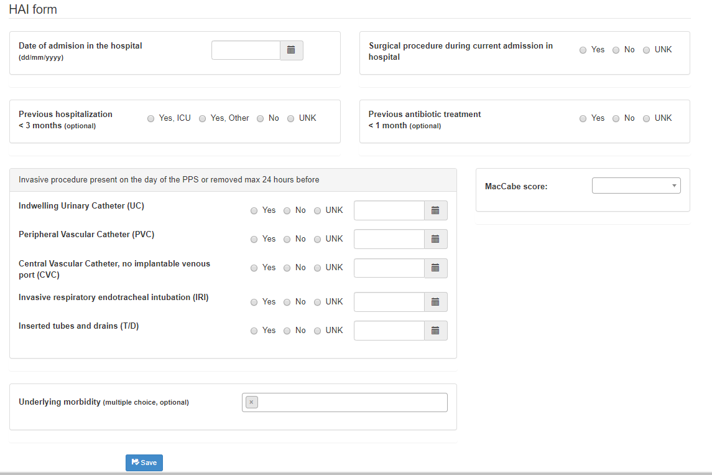
HAI form - Optional

Slide 34
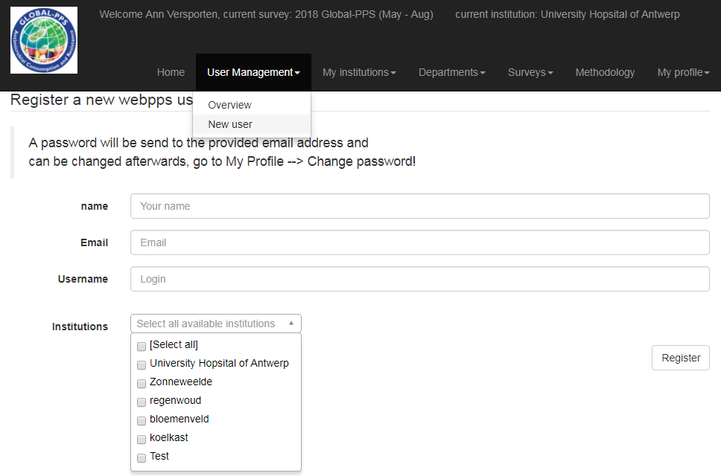
Register extra users who will help you with data-entry for one or more hospitals.

Slide 35
Feedback of results to the sites
Extraction of your data containing raw data allowing verification and analysis of your hospital results (excel file).
Generation of simple, easy to use feedback on your hospital data ready to use for local presentations.
Feedback comparing the hospital site results to average results for the country (if at least 3 participating hospitals from the country) and region (continental results).
Sites participating for the second time will receive longitudinal results for the time points they participated (2015,2017, 2018, 2019, …).

Slide 36
Materials to help you to conduct the survey
The Frequently Asked Question list
The IT manual
The antimicrobial list (excel file)
PowerPoint slides on the method used
Translated data collection forms
Global-PPS poster: promote the study in your hospital (different versions, easy to translate)
Available online at www.global-pps.com/documents/

Slide 37
This hospital is participating in a worldwide study:
‘The GLOBAL POINT PREVALENCE SURVEY’ on Antimicrobial Consumption and Resistance
What is it all about ?
Data collection on antibiotic prescription patterns and resistance in the hospital
Comparison of national and worldwide data
Identification of feasible targets to improve antibiotic prescribing
Combat antibiotic resistance
Contact person: “enter name and/or department”
Notes:
Promote and get support for this study in your hospital, modify the posters available at http://www.global-pps.com/documents/ and poste them on walls in your hospital

Slide 38
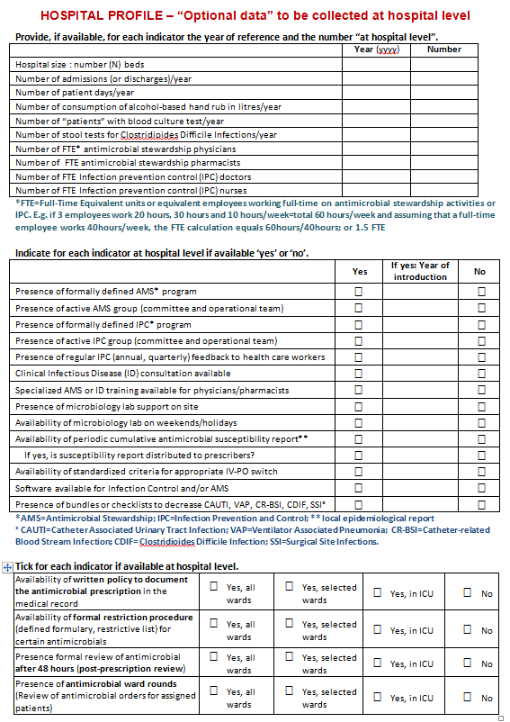
HOSPITAL PROFILE “Optional data” to be collected at hospital
Allows the evaluation of structure and process indicators at the hospital level which might facilitate antimicrobial stewardship interventions as well as patient safety
- available workforce
- available equipment, support
To be collected on a yearly basis.

Slide 39
Pitfalls of the Global-PPS
1-day PPS = cross-sectional snapshot of prescribing practice
    Seasonal variation
Lack of standardized clinical information
  diagnosis refers to what the clinician tends to treat (for example pneumonia)
No information on therapeutic antimicrobial course duration

Slide 40
Global PPS - Testimonials
“We followed your advice and made a survey team and it was such a nice opportunity for us to develop nice interaction, to further develop our extremely good cooperation. It was extremely useful that we surveyed together most of the wards. It was easier than we expected, staff were very collaborative and efficient, and we were very surprised how well it was achieved, having in mind that we did not opt to distribute posters and other stuff. It seems that people liked and welcomed our action. We hope that we will continue to collaborate with you, we are looking forward for any kind of collaboration!” (testimonial from Serbia)

Slide 41
Key message: meaningful comparisons
Uniformity of data collection - standardized protocol and data collection templates enabling the collection of valid and comparable antimicrobial consumption data
Simple protocol and web-based tool for data entry and validation = feasible & achievable surveillance
Quality assurance approach – implementation of data validation process
Central support toward data collection or other (helpdesk, FAQ, IT manual)
Continuous work on data accuracy
Opportunity to stimulate local networking
Mutual cooperation/feedback is highly motivating

Slide 42
Key message: toward data interpretation
Instant web report per hospital with quantifiable outcome measures and targets for quality improvement of antibiotic treatment and prophylaxis.
Enables in-depth interpretation of antimicrobial consumption data at different levels (geographical, institutional and patient characteristics).
Creation of reference database for scientific research and hypothesis formulation at national and international level (data are safeguarded at the University of Antwerp, Belgium).
Data-sharing upon agreement with all partners - publication policy is available

Slide 43
Features of the Global-PPS
Tool for assessing interventions to improve antibiotic prescribing in hospitals when PPS is repeated
Consistency and reproducibility
Improve healthcare quality
Combat antibiotic resistance
Improve antibiotic use for better patient health
“sustained awareness”

Slide 44

www.global-pps.com

Slide 45


Hospitals thereafter need to take the next step
“How can these results inform our stewardship activities?”
“What’s next?”
“Where to start?”
“Implement guidelines!”
“Identify the low-hanging fruit first!”
“If you can’t measure it, you can’t improve it!”
(Lord Kelvin)
“We need to restrict carbapenem use!”
“Repeat the Global-PPS”

Slide 46


Contact
global-PPS@uantwerpen.be
URL: www.global-pps.com

