Slide 1
Global Point Prevalence Survey of Antimicrobial Consumption and Resistance at Angkor Hospital for Children
Miliya T, Versporten A, Fox-Lewis S, Ngoun C,
Goossens H, Turner P

Slide 2
Background: Global-PPS
To establish a global network for data collection and monitoring the rates of antibiotic prescribing in hospitalized patients
Versporten A et al. Lancet Glob Health. 2018;6(6):e619-e29

Slide 3
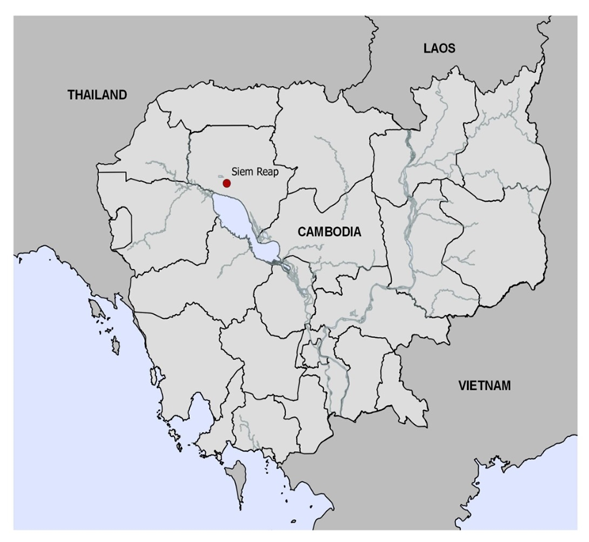
Background: site
Local aim
To better understand antimicrobial prescribing in a NGO hospital setting
Angkor Hospital for Children
A 100 bed non-profit paediatric hospital in Siem Reap and its satellite clinic
Children <16y
Emergency, PICU, NICU, IPD, Surgical and OPD departments

Slide 4
Methods
The survey was conducted in March 2017
Included all patients admitted and receiving a systemic antimicrobial on the day of the survey
Used the Global PPS CRF to collect details of:
Antimicrobial agent
Reason and indication for treatment
Appropriateness
Data were entered into the global web application

Slide 5
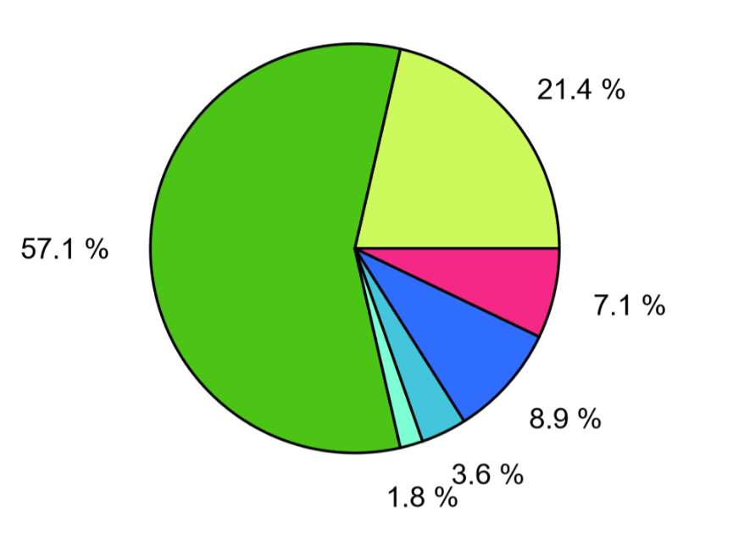
Results
A total 76 patients were included in the surveillance
Overall antimicrobial prevalence was 53.9%
Highest on surgical ward (71.4%) and PICU (66.7%)
Notes:
most commonly third-generation cephalosporins.

Slide 6
Results
The majority of prescriptions were empiric treatment for community acquired infections
Most common diagnoses that were treated with a therapeutic antimicrobial
Sepsis : 12 (27.3%)
Pneumonia : 8 (18.2%)
Gastroenteritis : 4 (9.1%)
Pyomyositis : 3 (6.8%)
Skin / soft tissue infection : 3 (6.8%)

Slide 7
Results
More than 70% of antibiotic prescriptions were appropriate as judged by compliance with hospital guidelines
Less optimal
Duration of surgical prophylaxis (>1 day in 100%)
Documentation of antimicrobial stop/review dates (<30% on all wards)

Slide 8
Conclusion
The PPS provided a snapshot of antimicrobial prescribing at AHC
The high prevalence of antimicrobial use stimulated development of a hospital antimicrobial stewardship committee and an enhanced clinician education programme
A local quarterly PPS protocol was implemented in June 2017 to monitor prescribing practices over time

Slide 9
Questions ?
www.global-pps.com
Thank you very much for your attention

